Slide 1

Khulna University of Engineering & Technology
Department Of Computer Science And Engineering
CSE 4120: Technical Writing and Seminar
ANS-based compression and encryption with 128-bit security
Authored By:
Seyit Camtepe, Jarek Duda, Arash Mahboubi, Pawel Morawiecki, Surya Nepal, Marcin Pawlowski, Josef Pieprzyk
Source:
Springer IJIS
DOI: https://doi.org/10.1007/s10207-022-00597-4
Presented By:
Partho Choudhury Shoumya
Roll: 1807021

Slide 2
Outline
Problem Statement
Objectives
Introduction
Related Works
Methodology
Result Analysis
Discussion & Conclusion
References

Slide 3
Problem Statement
Bulk of internet interaction requires data to squeeze out redundant bits and then get encrypted to reduce communication bandwidth and provide security.
Requires 2 independent algorithms.
Single algorithm that does compression and encryption (called compcrypt) should provide benefits in terms of efficiency and security.

Slide 4
Objectives
To design a compcrypt algorithm using the ANS entropy coding so that:
cost(compcrypt) << cost(compression) + cost(encryption)
security(compcrypt) = security(encryption)
comp_rate(compcrypt) ≈ comp_rate(compression)

Slide 5
Introduction
In a noisy and unreliable communication channel, there remains a problem of data transmission.
Error correcting codes were developed to deal with the errors precisely.
Reverse problem still persists: redundancy of data.

Slide 6
Inroduction (Cont...)
Entropy encoding mainly focuses on how to remove redundancy from transmitted data which is extremely important for ever growing internet applications.
Asymmetric Numeral Systems (ANS) are a new and promising invention that provides both efficient and close to optimal entropy encoding.
It can ensure Confidentiality, Integrity and Authenticity

Slide 7
Related Works
Author | Approach | Problem
Duda j. [1] | Applying Haffman coding | Suboptimal
Duda J. et all. [2] | Arithmetic Range Coding | A heavy computation overhead
Duda and Niemiec [3] | Plain ANS | Completely defenceless against integrity attack
Table 1: Comparison of related works

Slide 8
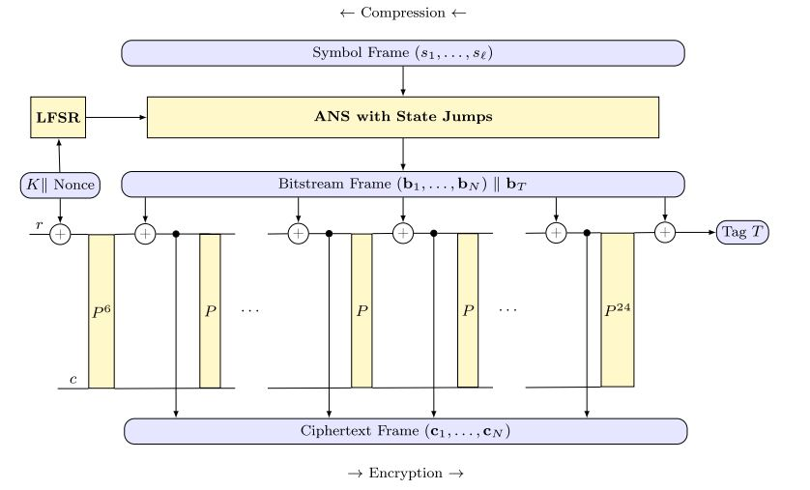
Proposed Methodology
Fig1: Compcrypt based on ANS and sponge, where r = 512 bits, c = 1088 bits and size of sponge state is b = 1600bits

Slide 9
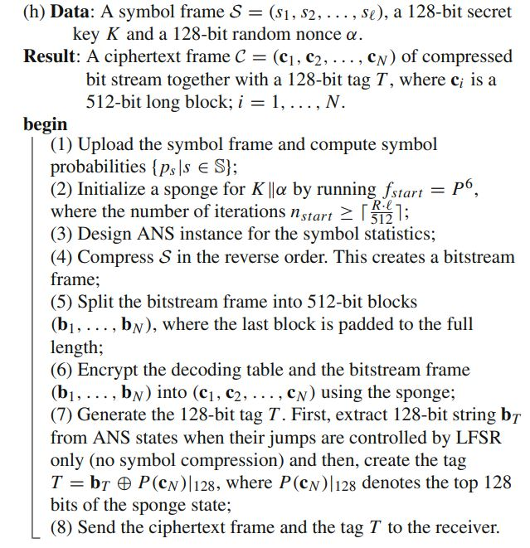
Methodology(cont.)
Algorithm depicting compression and encryption in a single process.
Fig 2: Compcrypt algorithm

Slide 10
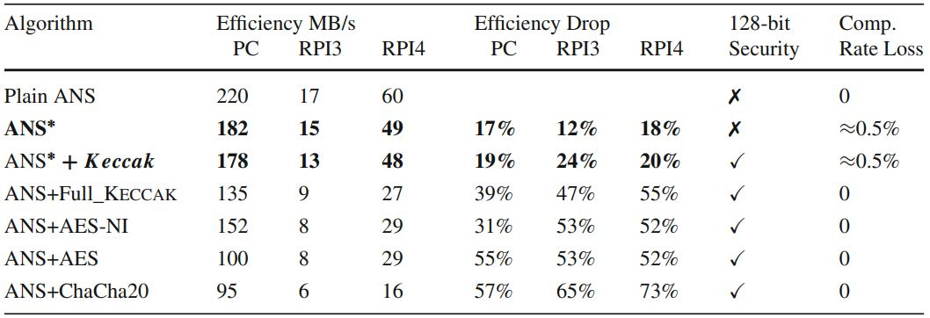
Result Analysis
Comparisons with other techniques indicating efficiency is shown in below table:
Table 2: Comparison of algorithms

Slide 11
Discussion & Conclusion
Prominent features:
Randomized ANS usage provides protection against statistical attack.
128 bit security provides protection against brute-force attack.
Flexible enough to scale the security and speed levels.
Some Caveats:
Compression rate is slow which could lead to bigger problems for large systems.
Compression loss is shown to be 0.5% which can lead to significant penalty if the algorithm is applied to large system.

Slide 12
References
[1] Duda, J.: Asymmetric Numeral Systems as Close to Capacity Low State Entropy Coders
[2] Duda, J., Tahboub, K., Gadgil, N.J., Delp, E.J.: The use of asymmetric numeral systems as an accurate replacement for Huffman coding. In: Picture Coding Symposium (PCS), Cairns, QLD, Australia, 2015, pp. 65–69
[3] Jarek Duda and Marcin Niemiec. Lightweight compression with encryption based on asymmetric numeral systems. arXiv preprint arXiv:1612.04662, 2016

Slide 13
Thank you

